Slide 1



FILM, TV AND SCREEN RESOURCE LIBRARY
Group 09
Deepkumar Patel
Dharmit Panchal
Vatsal Prajapati
Big Data Analytics – BDAT1011

Slide 2

PROJECT SUMMARY
To use Data Analytics tools to mine/scrape information and build a user-friendly database, that the company can interact with to get information about film and television resources in various regional markets that will indeed help the company make an educated investment.

Slide 3
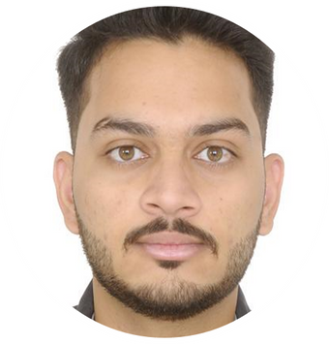


DEEPKUMAR PATEL
DHARMIT
PANCHAL
VATSAL PRAJAPATI
Team Leader
Python Developer
Data Architect
Data Engineer
Database Administrator
Business Analyst
Python Developer
Data Architect
Data Analyst

Slide 4

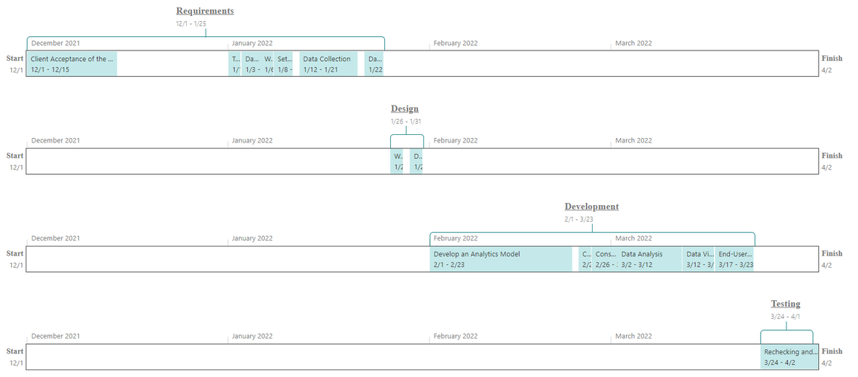
TIMELINE CHART

Slide 5

CONSUMPTION

Slide 6
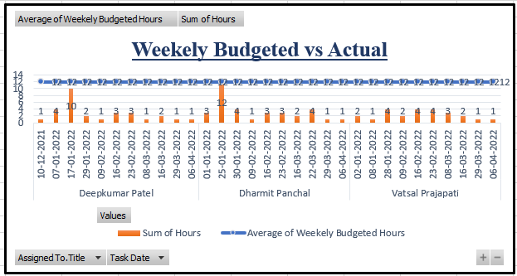
WEEKELY BUDGETED VS ACTUAL

Slide 7
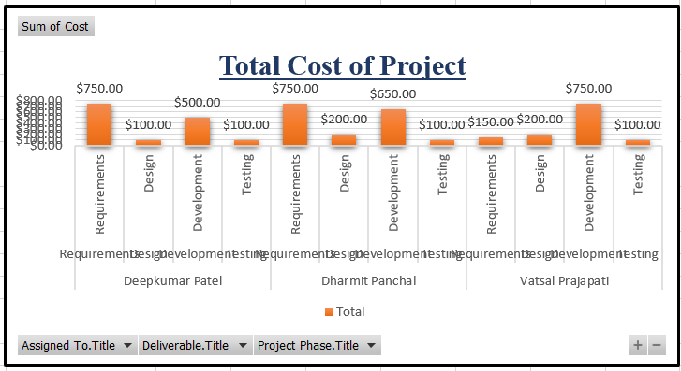
TOTAL COST OF PROJECT

Slide 8
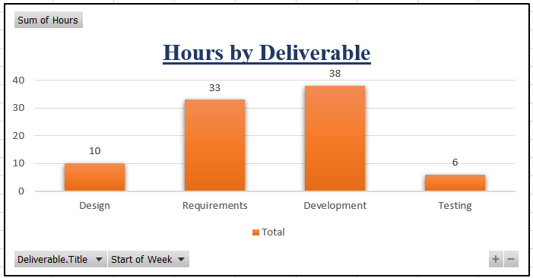
TOTAL HOURS BY DELIVERABLE

Slide 9
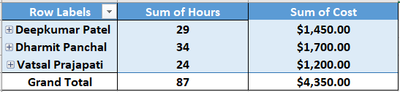
TOTAL HOURS & COST BY PERSON

Slide 10
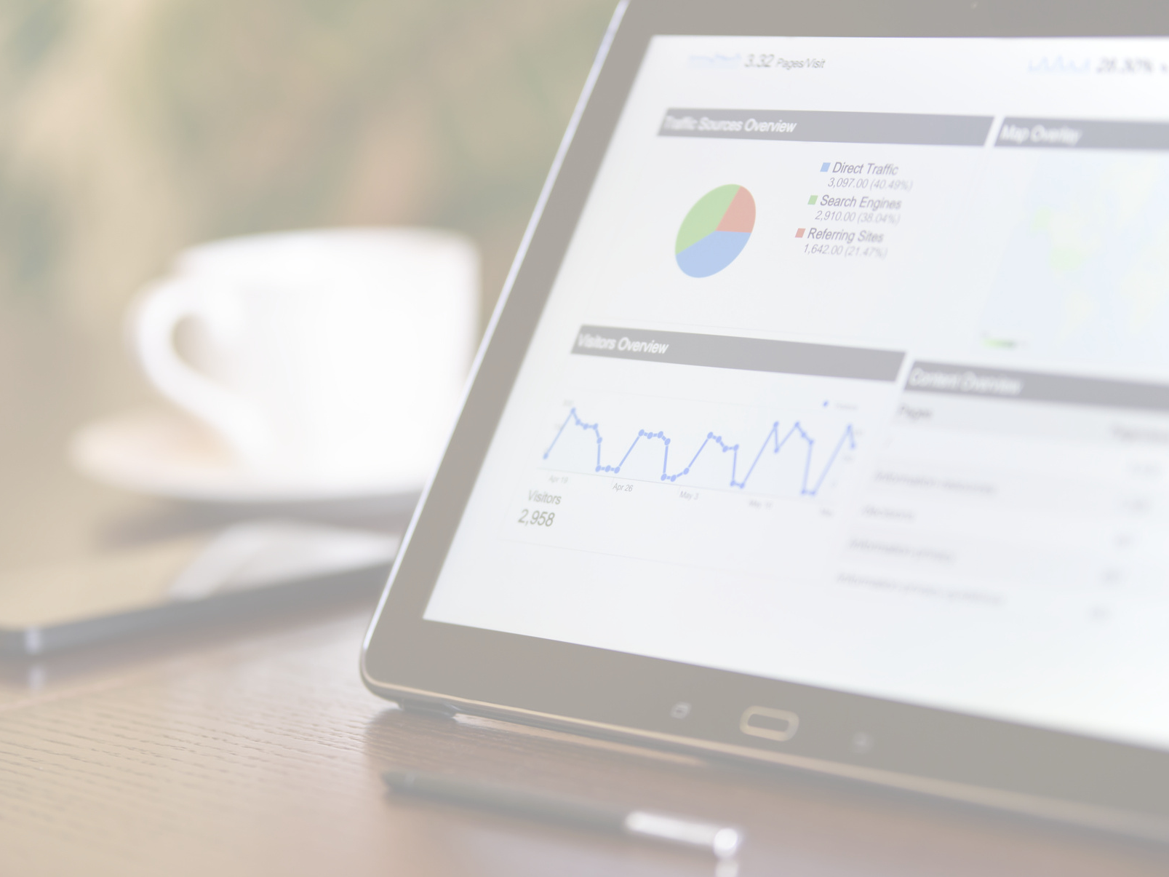
DELIVERABLES

Slide 11
DATASOURCES
https://www.statcan.gc.ca/en/start
https://www.novascotiabusiness.com/
https://canadacouncil.ca/
https://telefilm.ca/en/transparency/proactive-disclosure/grant-contribution/reports-by-quarter
https://ontariocreates.ca/our-sectors/film-tv/film-fund/funding-recipients-1

Slide 12
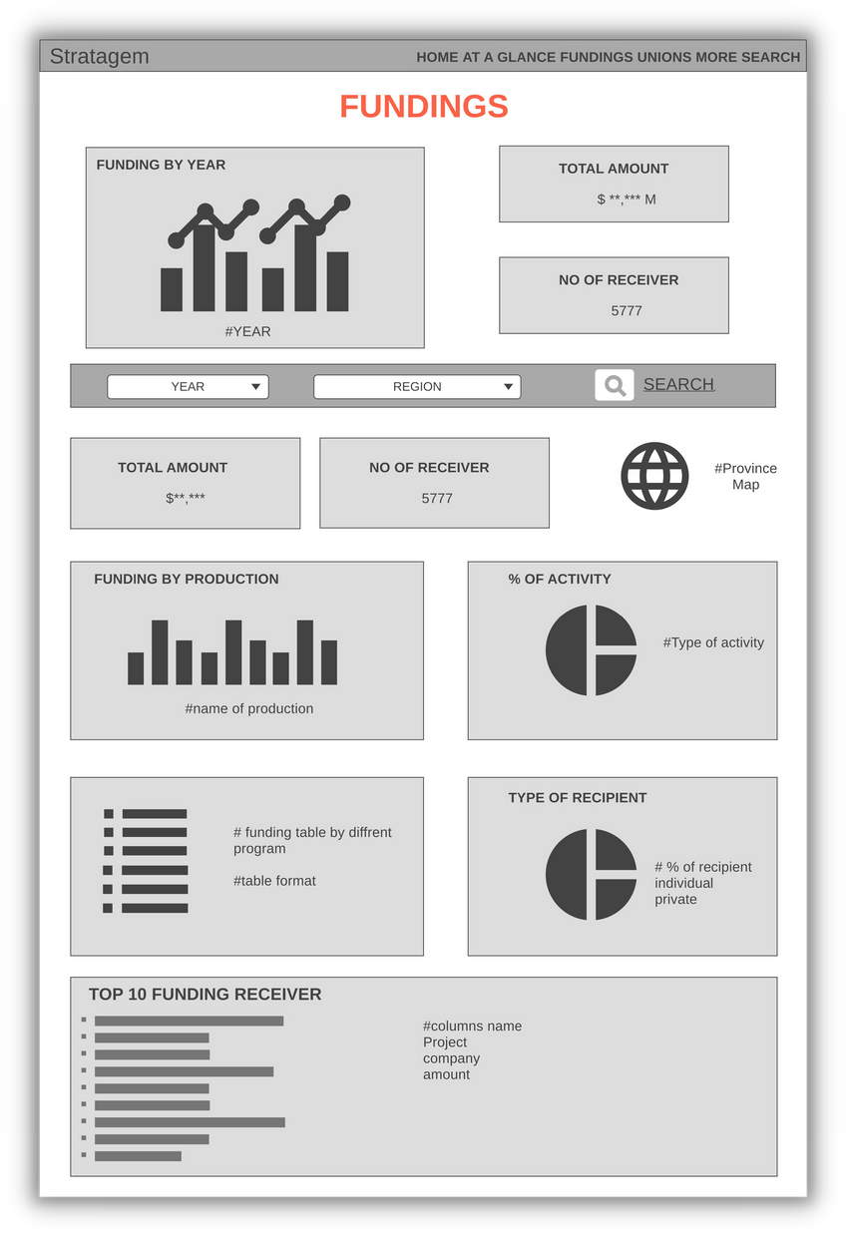
WIREFRAME OF THE DASHBOARD

Slide 13
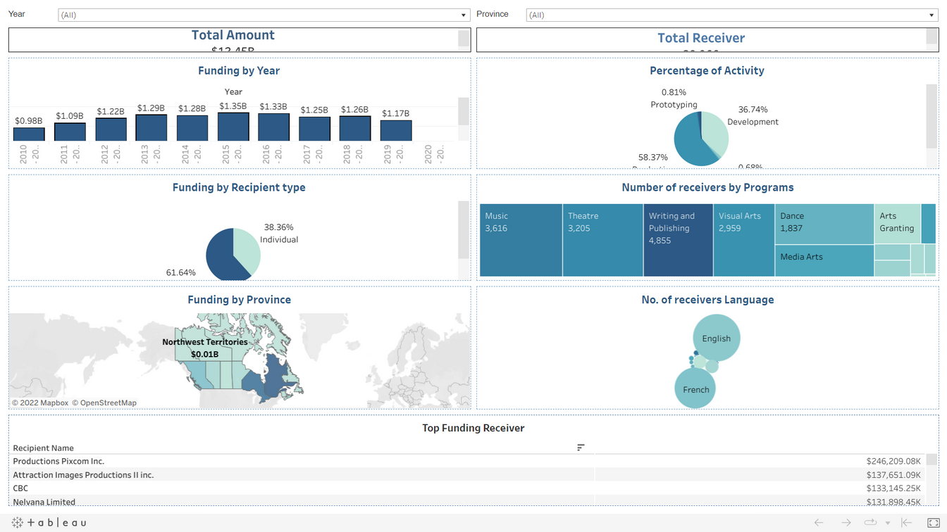
VISUALIZATION DASHBOARD

Slide 14
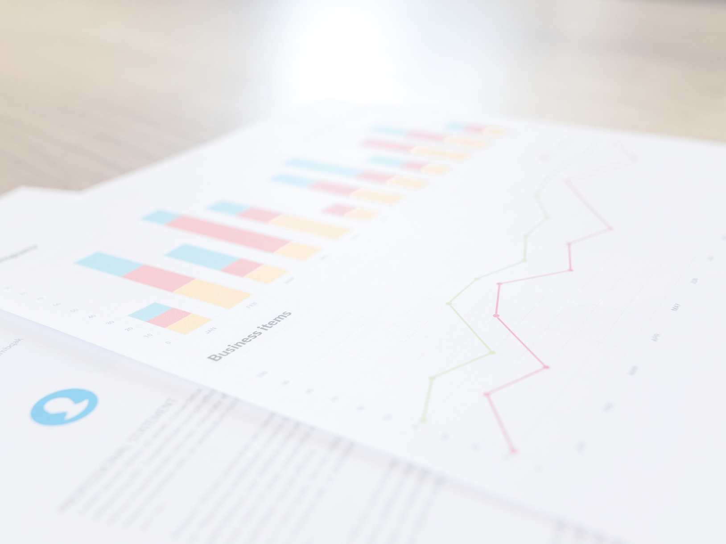
LIVE DEMO

Slide 15
LINKS
LINKS
SHAREPOINT LINK:
https://georgiancollege.sharepoint.com/sites/stratagemfilmtvandscreenresourcelibrary/Stratagem/2021F/SitePages/2021F-Project-Dashboard.aspx?web=1http://
WEbexLINK:
HTTPS://GEORGIANCOLLEGE.WEBEX.COM/RECORDINGSERVICE/SITES/GEORGIANCOLLEGE/RECORDING/PLAYBACK/966F39BB76E7103ABFB90050568C9E76
Password: nCfCCsn8

Slide 16
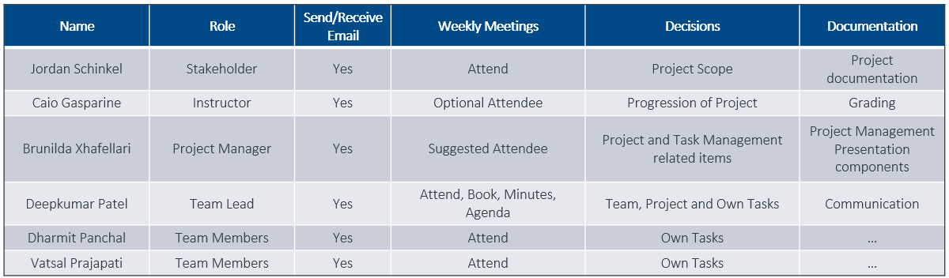
COMMUNICATION PLAN

Slide 17

QnA

Slide 18

THANK YOU!

